Slide 1
API (Application Program Interface)
RPC: Remote Procedure Call (Legacy)
SOAP: Simple Object Access Protocol (More sophisticated)
REST: Representational state transfer (very flexible)

Slide 2
API – Application Programming Interface
Interface – separates how from what
With interface you care about what but not how, provides highest level abstraction

Slide 3
SOAP and REST
Loosely coupled (Operating system agnostic)
Language agnostic ( you can develop in one language and consume in different language, i.e. develop service in c++, but consume in java, c#, javascript, python or ruby)
Data will be exchanged in xml in case of SOAP
Rest can work on plain text, html, xml, json, YAML and blob.
https://raygun.com/blog/soap-vs-rest-vs-json/

Slide 4
REST (Http Verbs and Responses)
GET : to get data (may need query params)
HEAD: to get only headers
POST: indicates data being send is to be created (NEW) (needs body + optional query string)
PUT: to update data already present (needs body + optional query string)
DELETE: to delete data (no body needed, you pass identifier in url)
OPTIONS: when target is different than origin of the site, CORS (Cross Origin Resource Sharing)
More (https://developer.mozilla.org/en-US/docs/Web/HTTP/Methods)

Slide 5
HTTP Response
200 -> OK
201 -> Created
203 -> Non
204 -> No Content
400 -> Bad Request
401 -> Unauthorized
403 -> Forbidden
404 -> Not found
500 -> Internal Server Error

Slide 6
Get Http Request Parts
Url (Request Url)
Method type: GET
Data will be passed in url in form or querystring e.g. in url below
https://example.com/path/to/page?name=ferret&color=purple
Below are Query parameters
name=ferret and
color=purple

Slide 7
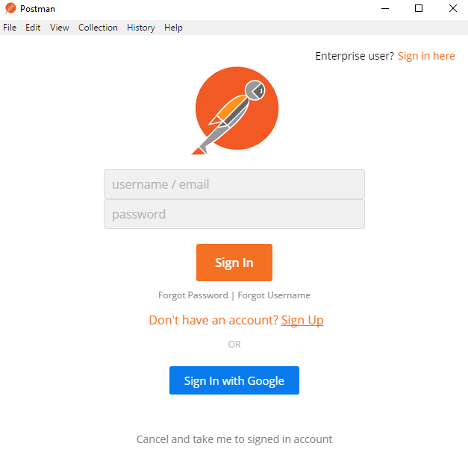
Manual REST api testing (Postman)
Download -> https://www.getpostman.com/downloads/
Install this once downloaded
Try to open it and then try to sign in
With google account.

Slide 8
Other references
https://swagger.io/tools/swagger-ui/
https://petstore.swagger.io/ (swagger pet store)
https://jsonplaceholder.typicode.com/
Automation rest assure demo
https://github.com/rdankhara/JavaRestAssured

Slide 9
Advance section Api, Messaging automation
Serialisation (https://github.com/FasterXML/jackson-databind)
Messaging (https://www.baeldung.com/rabbitmq)

